Slide 1
Data Structures & Algorithms SECP2043
Section P3
Lecture 2
26-10-22

Slide 2

Algorithm Analysis: The Big-O Notation
Holiday season → Gift shop expecting sales to rise → Hired extra delivery people → Calculate shortest path and hand route to the driver.
50 packages to be delivered to 50 different houses
50 houses are 1 mile apart in the same area

Slide 3

Scheme 1 for package delivery
Driver 1 picks 50 packages → Drive a mile to deliver first package → drive another mile to deliver second package → …
Using this scheme distance travelled to deliver is 1 + 1 + … + 1 =50
Total distance travelled = 50 + 50

Slide 4
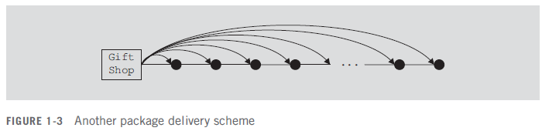
Scheme 2 for package delivery
Driver 2 picks 1st package → Drive a mile to deliver first package → Comes back to shop → Picks 2nd package and Drive 2 miles to deliver → Comes back to shop …
Using this scheme total distance travelled to deliver packages and return to shop is
2 . (1 + 2 + … + 50) = 2550

Slide 5
Generalized Number of Packages
Suppose n packages to be delivered to n houses and each house is 1 mile apart
First Scheme
1 + 1 + … + 1 + n = 2n (1-1)
Second Scheme
2 . ( 1 + 2 + … + n) = 2 . (n (n+1)/2) = n² + n (1-2)

Slide 6
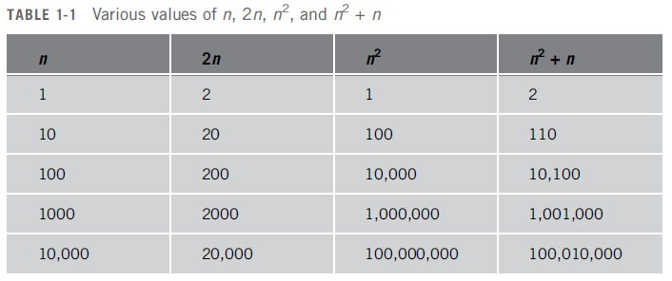
Total Distance Travelled
Equation (1-1) distance travelled is function of n
Equation (1-2) distance travelled is function of n² only as it is the dominant term

Slide 7
Figure of Merit for Algorithm Performance
Focus on number of operations performed by the algorithm
Not on the actual computer time to execute the program
Same algorithm can be implemented on a variety of computers resulting in different execution times
However, the number of operations preformed by the algorithm remains same

Slide 8
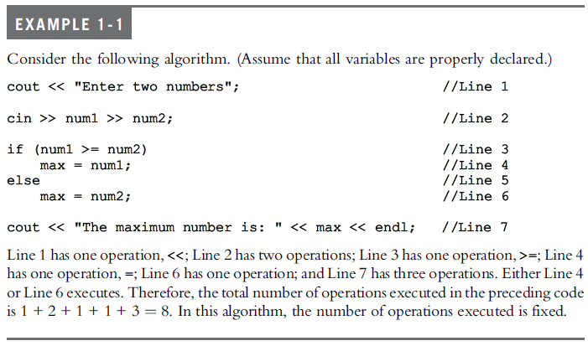

Slide 9
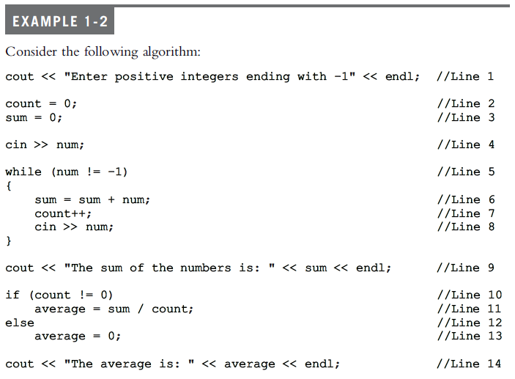
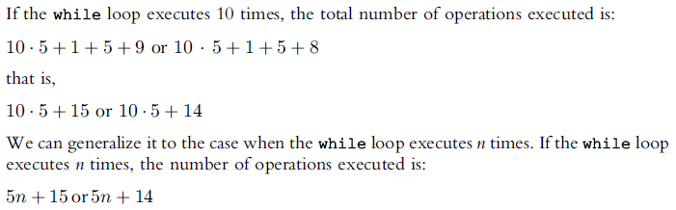

Slide 10
Dominant terms
Usually, in an algorithm, certain operations are dominant. In previous example line 6 addition and line 11 division are dominant operations.
Search Algorithm → search item compared with items in list → the dominant operations would be comparison, therefore, in case of search algorithm we count the number of comparisons.
Multiplication of matrices → multiplication and addition of matrix entries → multiplication takes more computer execution time → number of multiplications are counted.

Slide 11
Search Algorithm
Suppose algorithm performs f(n) basic functions to accomplish a task. Where n is the size of the problem.
Search problem of list size n.
Various algorithms discussed in chapter 9.
Basic method → compare search item with the list elements
Performance of algorithm depends on the number of comparisons n.

Slide 12
Search Algorithm
If n is the size of the list and f(n) becomes the count function, that is f(n) gives the number of comparisons performed by the algorithm.
Suppose on a particular computer c time is taken for one operation.
Computer time for search algorithm will take cf(n). Constant c depends on the speed of the computer that varies from computer to computer.
However, f(n), the number of basic operations remains the same.
If we know how f(n) grows as the size of the problem grows, we can determine the efficiency of the algorithm.

Slide 13
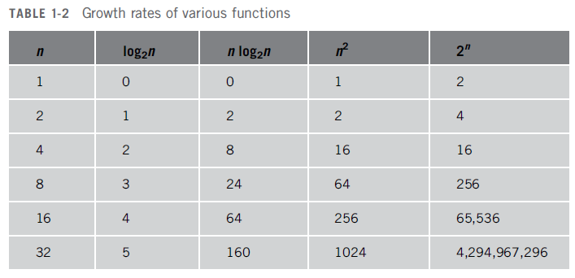
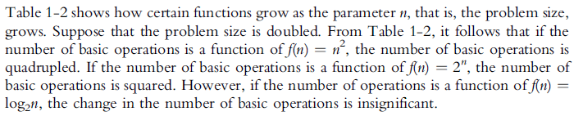

Slide 14
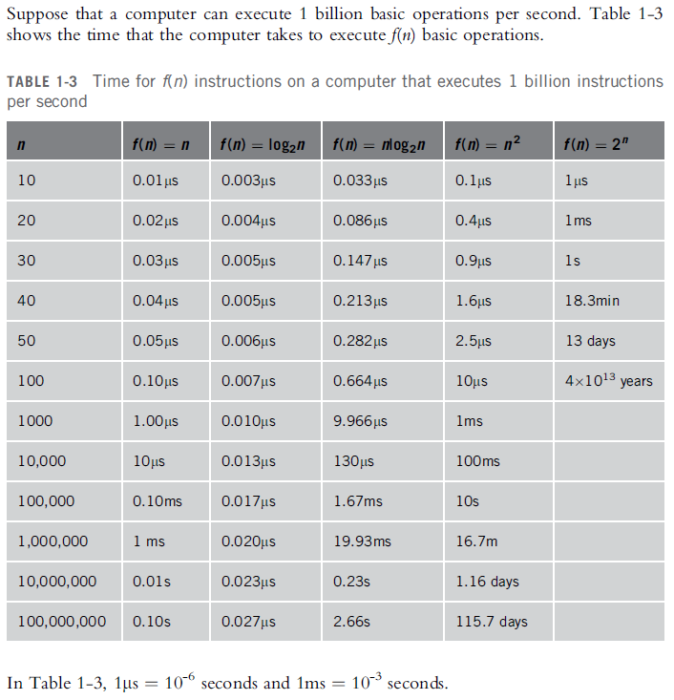

Slide 15
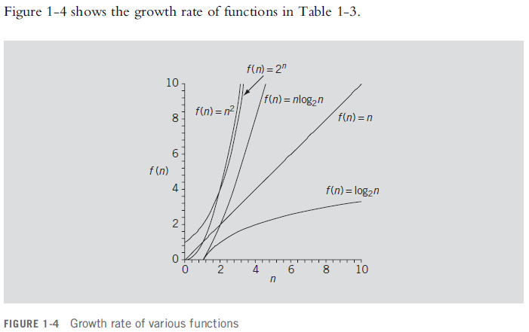

Slide 16
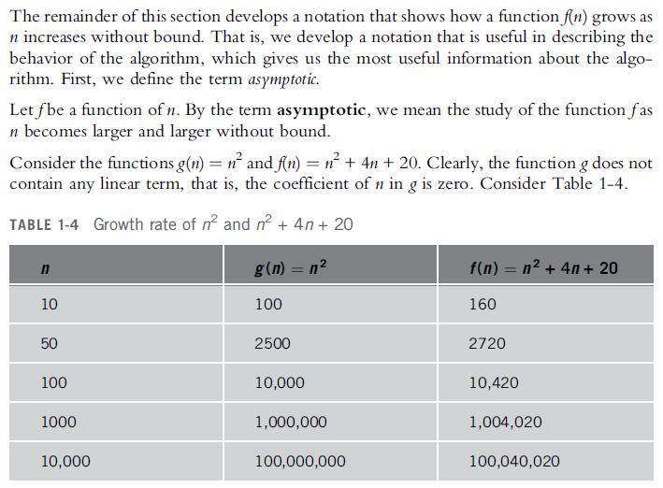
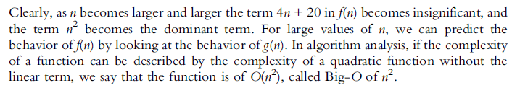

Slide 17
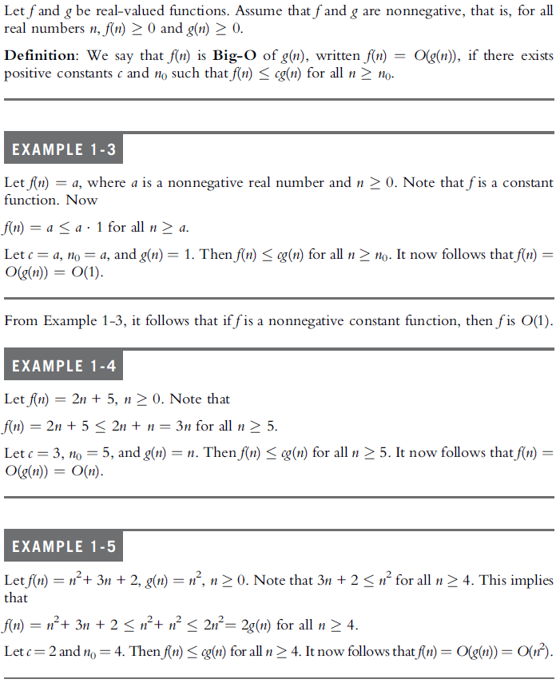

Slide 18
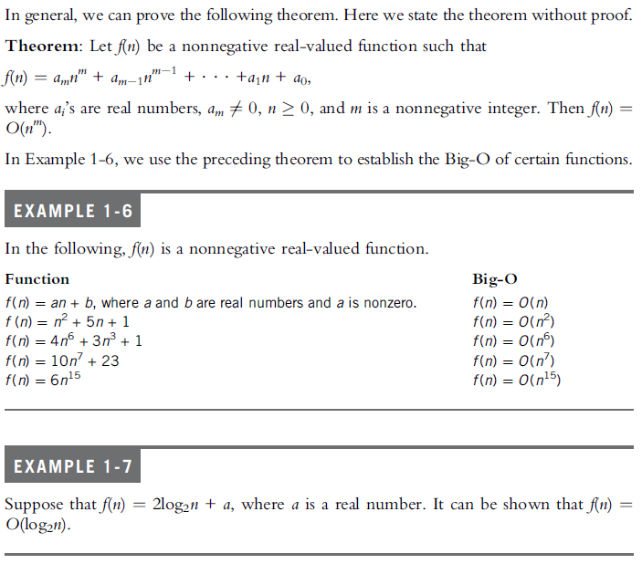

Slide 19
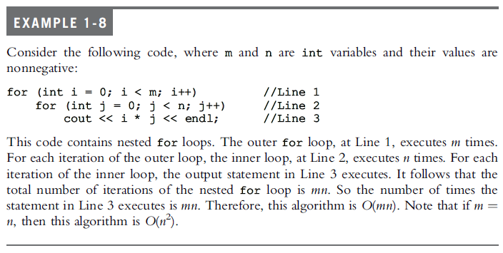

Slide 20
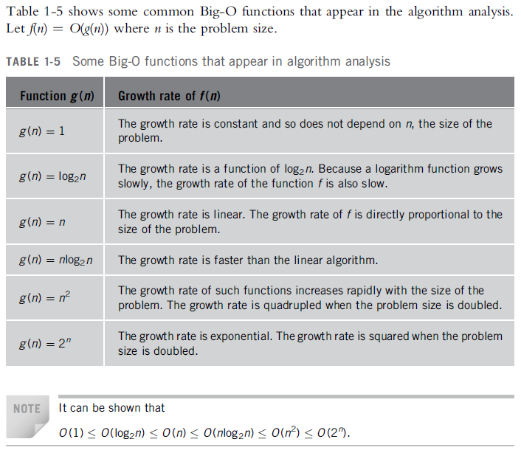

Slide 21
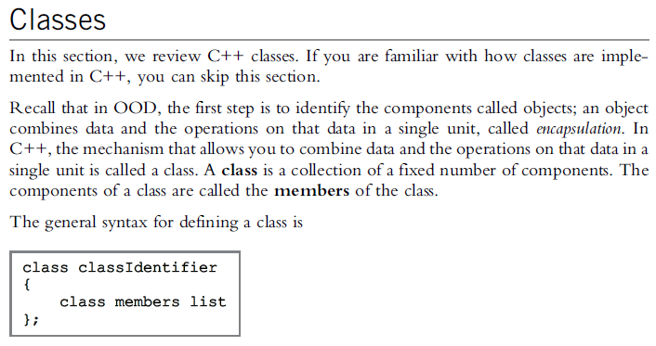
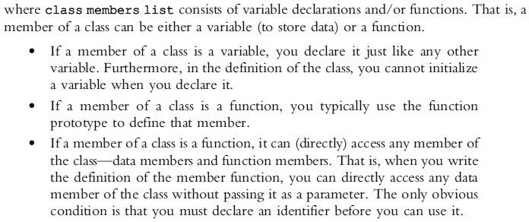

Slide 22
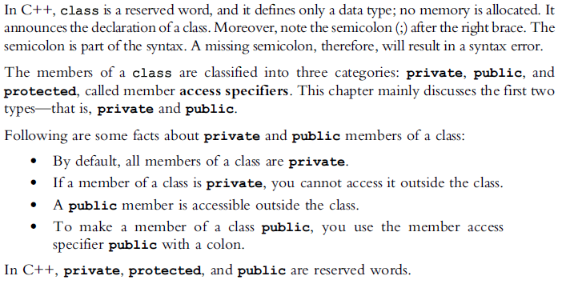

Slide 23
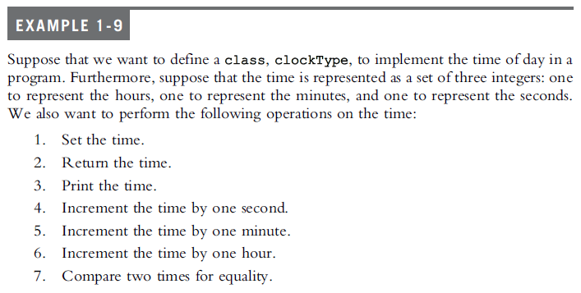
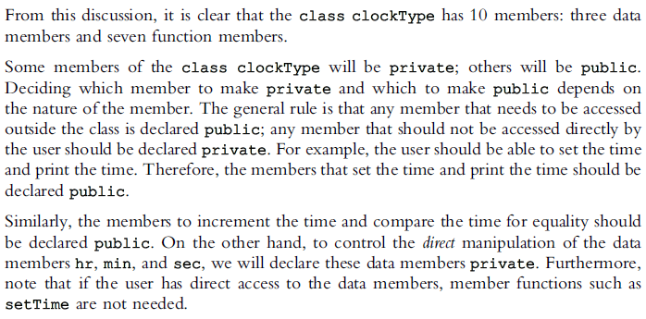

Slide 24
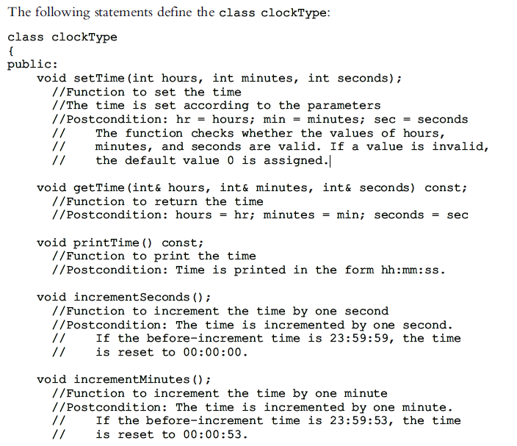

Slide 25
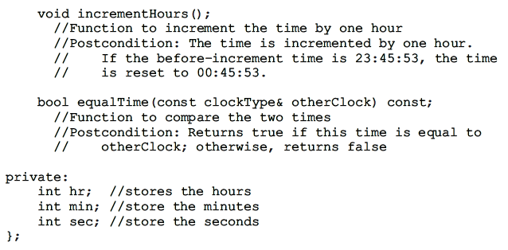

Slide 26
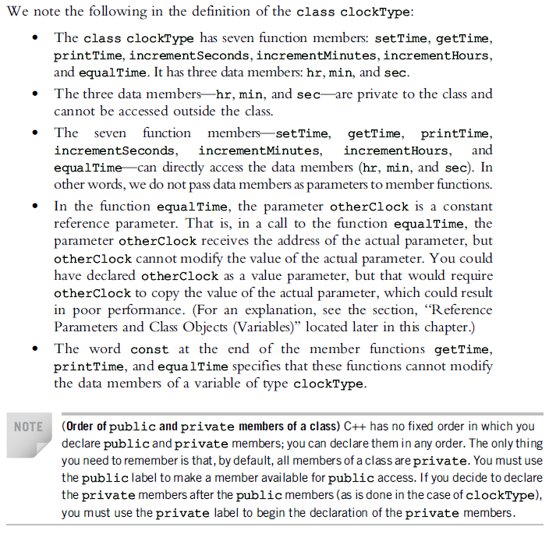

Slide 27
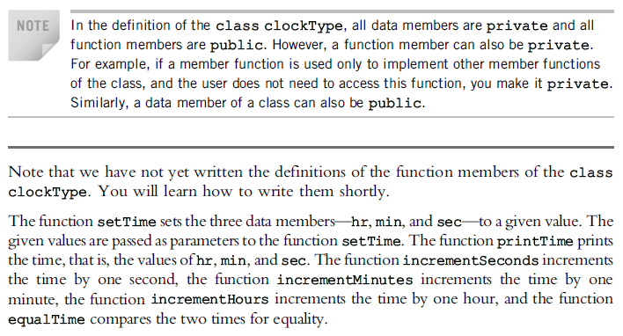

Slide 28
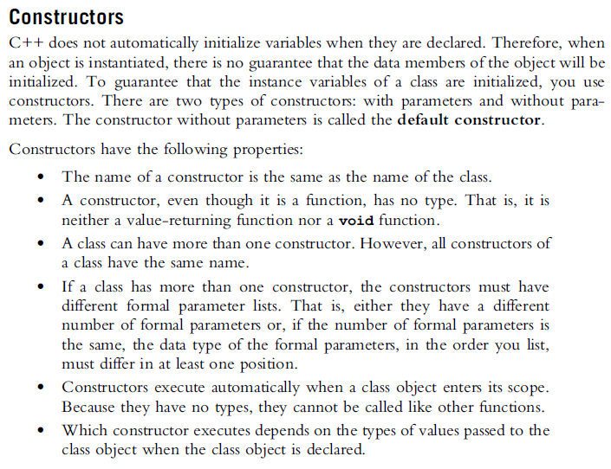

Slide 29
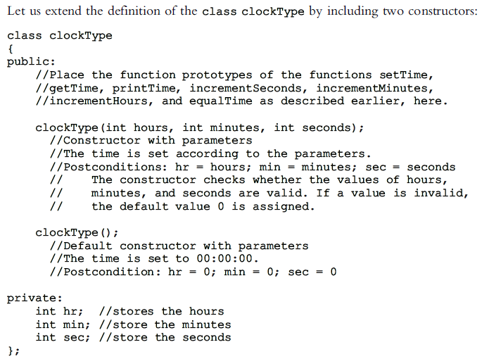

Slide 30
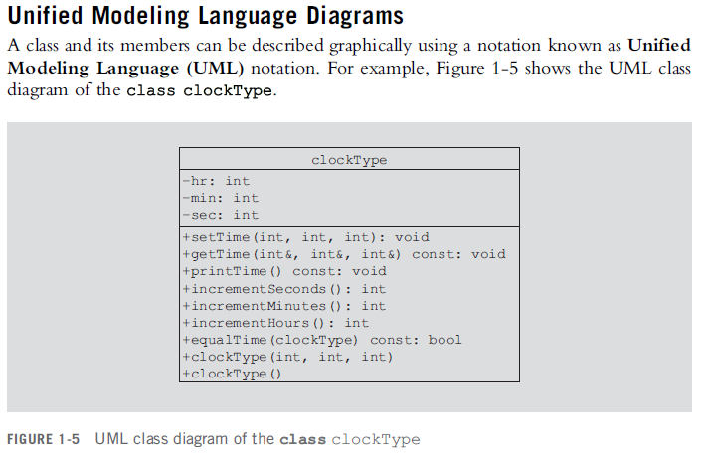
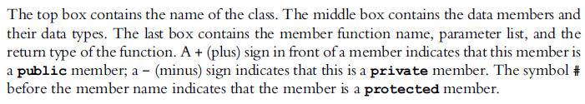

Slide 31
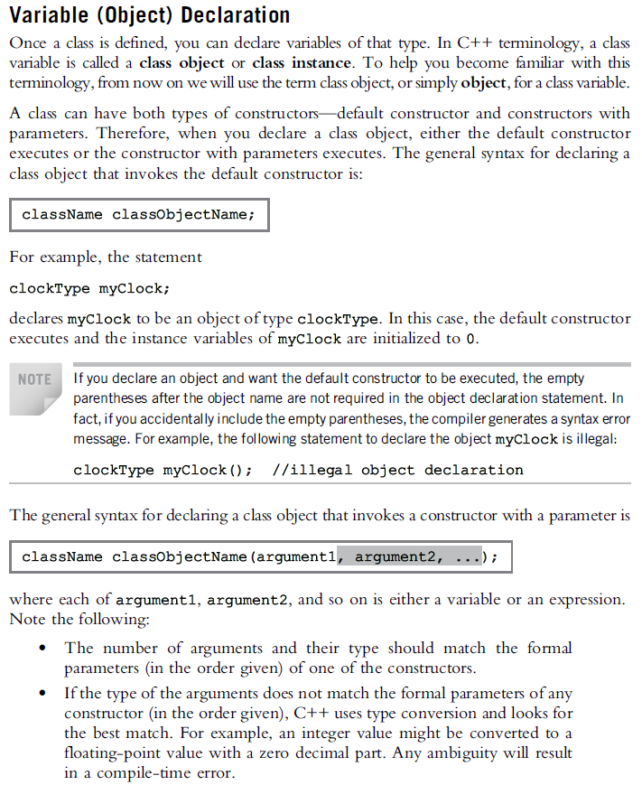

Slide 32
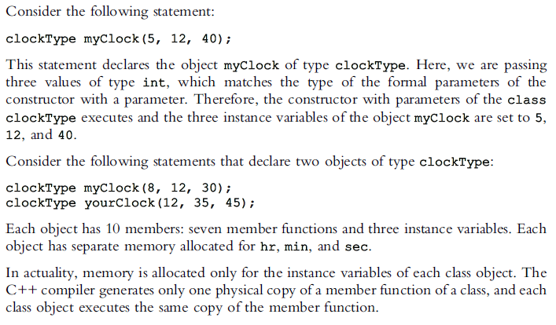

Slide 33
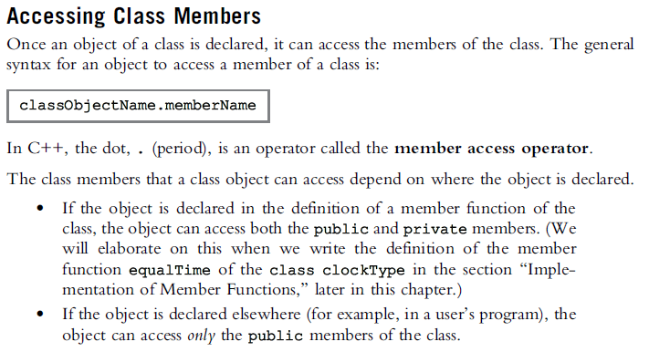

Slide 34
